Slide 1
Election 2012 U.S. Consulate General Frankfurt
Notes:
Introduce self, very short bio
Hope to learn from each other
Please raise hand if you have a question or comment
I’ll certainly have lots of questions for you
Who has been to the US? During Election season (2000, 2004, 2008)?
A Special time in America: People turning off TVs in droves to avoid political advertising

Slide 2
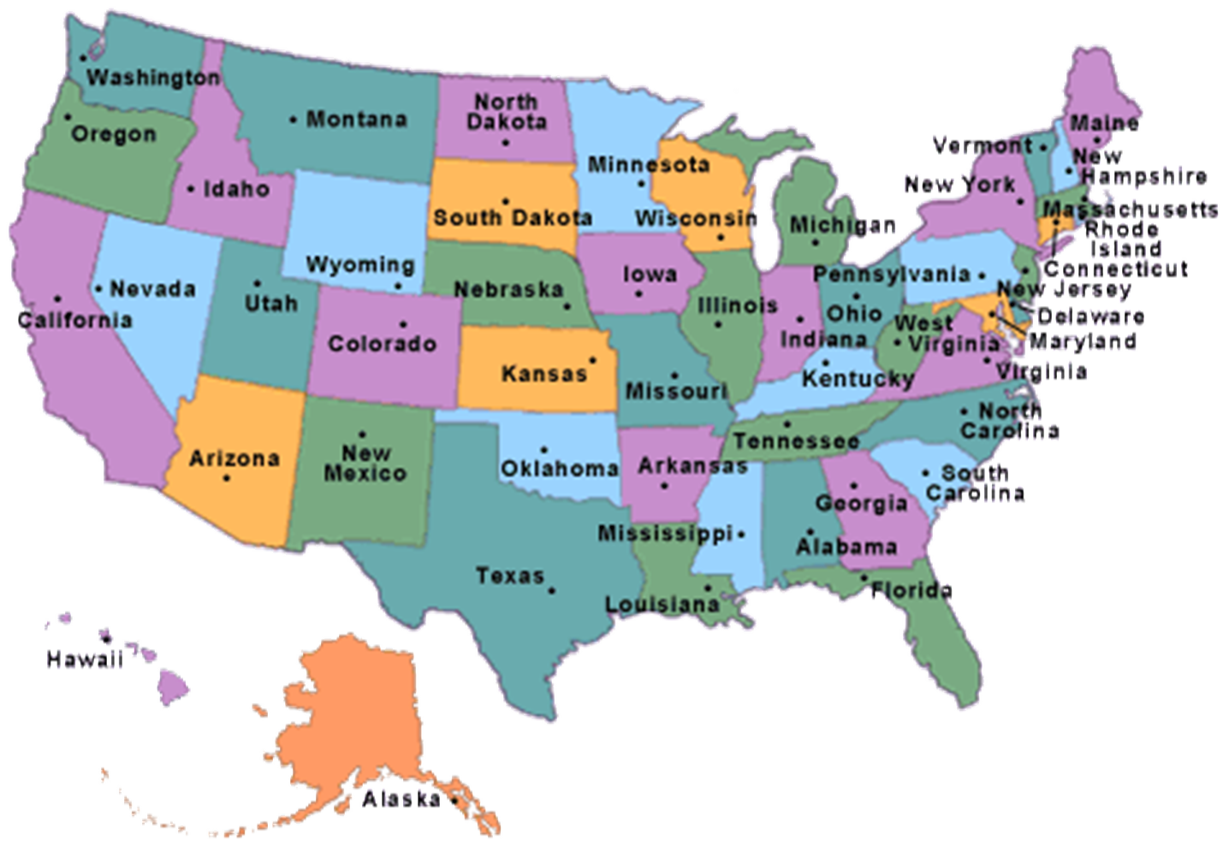

Slide 3
The American party system
Notes:
One way to think about our elections is to look at the whole period from one election to the next as a cycle that repeats itself.
This is true not just for President, but for other offices as well. Some of the details are different, but many things are similar between all elections in the US.

Slide 4
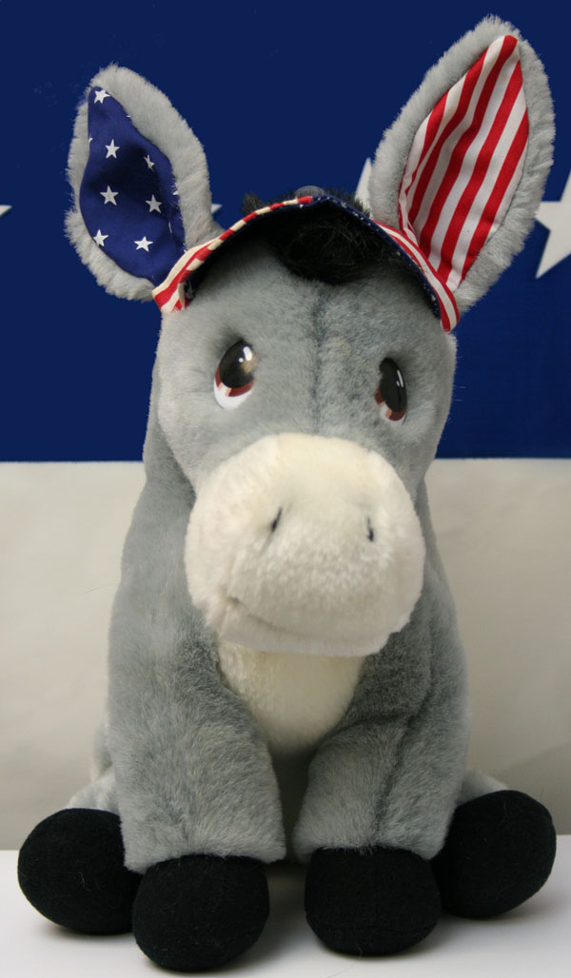
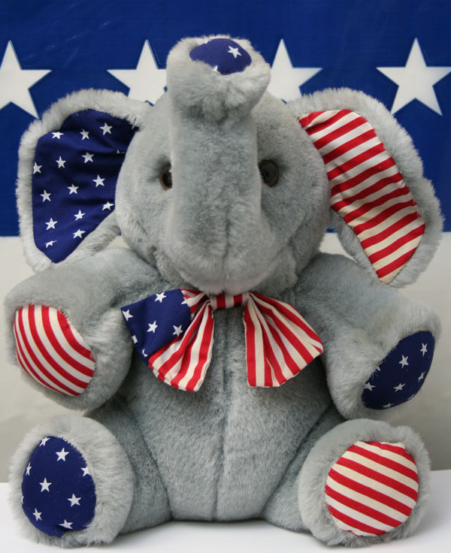
The American party system - Which are the two Major parties ? -

Slide 5
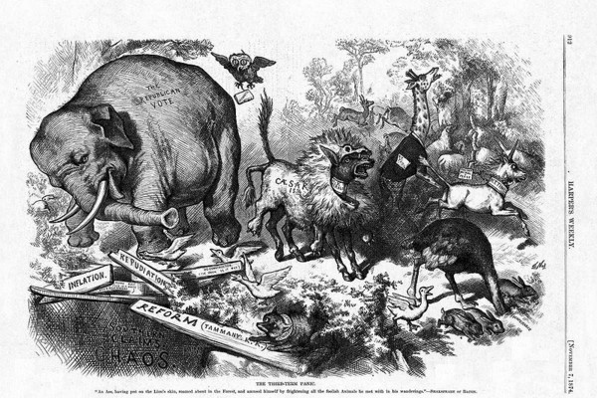
Who invented the two major parties’ mascots?
Created by Thomas Nast (Born in Landau, Germany) who used both in his political cartoons for Harper’s Weekly in the 1870’s
Notes:
Thomas Nast was a German immigrant born in Landau, Pfalz. He arrived in New York at the age of six and started working at newspapers at the age of fifteen. He was a political cartoonist, and is responsible for the creation of the symbols for both the Republican and Democratic Parties.
He symbolized the Republican party as an elephant and the Democratic Party as a donkey. Originally they were in negative context, however, they stuck and became adopted as the image of the political party systems and have been used since the 1870s.
Pictures: Thomas Nast. (Public Domain) This picture was showing the donkey dressed up in a lion’s skin parading around terrorizing the other zoo animals. The fleeing elephant represents the Republican vote. (Public Domain)

Slide 6
Political labels & parties
Conservatives – Republican Party
Where do conservatives/Republicans stand on key political issues?
Strong defense, lower taxes, pro-business, less state spending, law and order, small government, death penalty, guns, anti-abortion
Notes:
Some parallels to Germany, where most people aren’t members of party, but do habitually vote for one or the other.
How many Germans are members of the SPD? Actually only about 800,000.
Similarly, in the US most citizens aren’t officially members of the parties they support, although about 45% each say they consistently support one or the other major party.

Slide 7
Political labels & parties
Liberals – Democratic Party
Where do liberals/Democrats stand on key political issues?
Higher taxes for the rich, affordable health care for all, social security, higher minimum wage, gun control, abortion, environmental protection
Notes:
Some parallels to Germany, where most people aren’t members of party, but do habitually vote for one or the other.
How many Germans are members of the SPD? Actually only about 800,000.
Similarly, in the US most citizens aren’t officially members of the parties they support, although about 45% each say they consistently support one or the other major party.

Slide 8
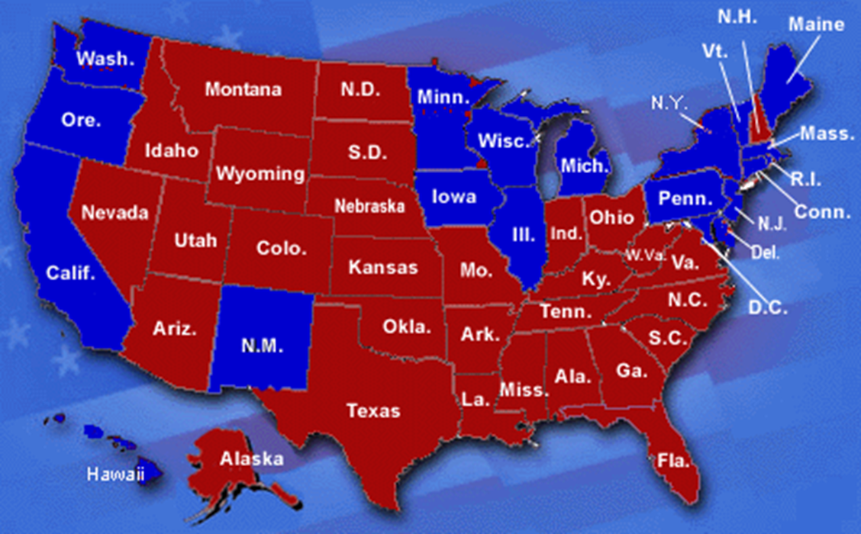
Red vs. Blue States
Source: usnews.com (2000 election)
Notes:
So as you can see, Republicans have a stronghold in the South and Midwest while Democrats typically take the Northeast and the Pacific states.

Slide 9
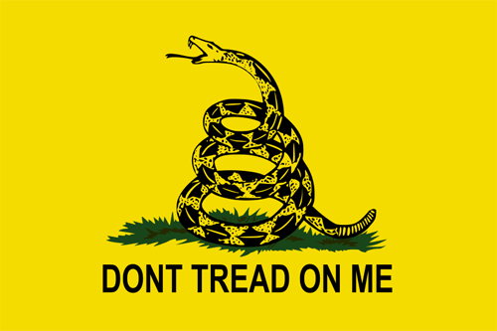
Which other political parties in the U.S. do you know?
Tea Party
Notes:
How many US political parties are there; can you name them?
Although known as a two party system, since the Repub. And Dem. Parties are dominant, there are other parties (such as the Libertarians and Greens) as well as independent candidates (Ralph Nader, while supported by the Greens, is running as an independent in many states).
Some candidates may only appear on the ballot in a few states.
Greens and Reform and Libertarians have won offices at the state and local level, but haven’t yet won a national/federal campaign.
The Tea Party has gained a lot of recognition in the past few years. It is not officially considered a party, but rather a movement. Many Tea Party supporters are actually Republicans, but the Tea Party is more conservative than most Republicans. It calls for strict interpretation of the Constitution, lower taxes, and a return to traditional US foreign policy practices. The reason they are significant is because of the Tea Party Caucus, as of 2011 there were 62 Republican representatives in the House of Representatives who identified themselves as part of the Tea Party movement.

Slide 10
Spectrum of U.S. political parties
Source: votingmad.wordpress.com
Notes:
So this part is really easy, we call anything from independent to fascism “the right,” and anything from independent to communism “the left.” the right is the conservative side, but we see varying levels of conservatism, as we do with varying degrees of liberalism on the left.

Slide 11
How Many Elections Take Place On November 6th?
President/Vice President
Senate (one third)
House of Representatives
States
Counties
Cities

Slide 12
The Election Cycle
Terms of Office
President
4 years
Senator
6 years
Representative
2 years
Notes:
One way to think about our elections is to look at the whole period from one election to the next as a cycle that repeats itself.
This is true not just for President, but for other offices as well. Some of the details are different, but many things are similar between all elections in the US.

Slide 13
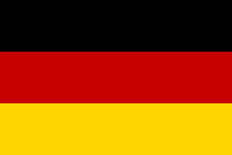
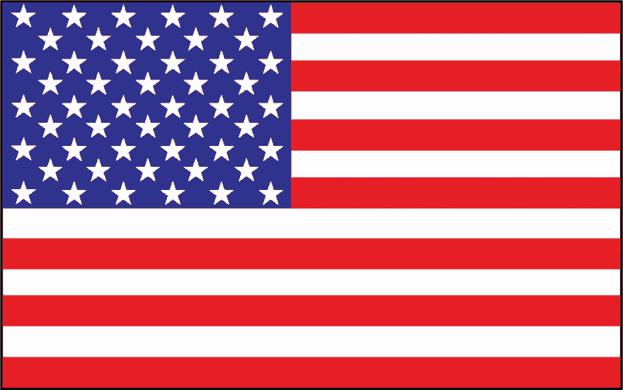
Who gets to Vote?
German Citizen
18 years old
Not deprived of right by criminal conviction
U.S. Citizen
18 years old
Not deprived of right
by criminal conviction
Registered voter

Slide 14
Voter registration and Political Parties in the U.S.
In order to be eligible to vote in any election, one has to “register” as a Republican, Democrat or Independent
Registered Republicans can vote in the Republican primaries, registered Democrats in the Democratic primaries
However: Registering as Republican or Democrat does not mean a formal membership in either party, since, unlike in Europe, American political parties are only loosely and rather informally organized. No formal members, no membership dues!
Notes:
Some parallels to Germany, where most people aren’t members of party, but do habitually vote for one or the other.
How many Germans are members of the SPD? Actually only about 800,000.
Similarly, in the US most citizens aren’t officially members of the parties they support, although about 45% each say they consistently support one or the other major party.

Slide 15
Voter registration

Slide 16
The Presidential Election process
Notes:
One way to think about our elections is to look at the whole period from one election to the next as a cycle that repeats itself.
This is true not just for President, but for other offices as well. Some of the details are different, but many things are similar between all elections in the US.

Slide 17
German-American differences
Who determines the candidates for Chancellor in Germany?
Leaders/members of the political parties
Who determines the candidates for President in the United States?
Registered voters

Slide 18
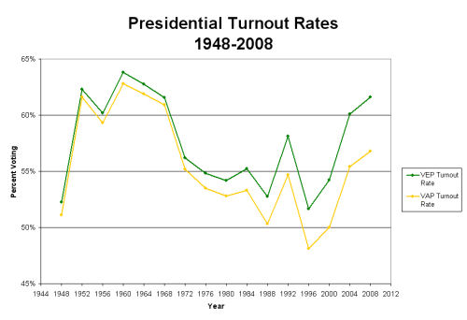
Voter turnout in U.S. Presidential Elections
Source: United States Election Project/George Mason University
Notes:
Voter turnout rates presented here show that the much-lamented decline in voter participation is an artifact of poor measurement. Previously, turnout rates were calculated by dividing the number of votes by what is called the "voting-age population" which consists of everyone age 18 and older residing in the United States (the yellow line to the right). This includes persons ineligible to vote, mainly non-citizens and ineligible felons, and excludes overseas eligible voters. When turnout rates are calculated for those eligible to vote, a new picture of turnout emerges, which exhibits no decline since 1972 (the green line to the right). Indeed, turnout rates appear to have been restored to their earlier high levels as of 2008.

Slide 19
What is the result of voter selection of the presidential candidates?
Primary elections –
an extended election campaign before the actual presidential election campaign

Slide 20
Who can compete in the primary elections?
Anyone can declare his/her candidacy for a party without consent or endorsement of the party

Slide 21
Who becomes a party’s nominee for the Presidential elections?
The candidate with the majority of the delegates wins in the primary elections.

Slide 22
The Election Cycle
2011: Rise of the Candidates
Jan. – June 2012: Elections of candidates in primaries and caucuses
August 27, 2012, Tampa, Florida:
Republican National Convention
Sept. 3, 2012, Charlotte, North Carolina:
Democratic National Conventions
Nov. 6, 2012: General elections
December 2012: Electoral College officially elects the President
January 20, 2013: Inauguration of the President in Washington

Slide 23
One thing to keep in mind: The United States has a federal system which means Every single state has regulations - on everything from election rules to gun laws - which can be different from those in other states

Slide 24
Primary Elections
State by state contests for each political party
However: this year the Democratic Party has no primary elections. Why not?
President Obama is seeking reelection for a second term and therefore is the unchallenged candidate for the Democratic Party
Notes:
Here is a point at which German and US systems differ significantly.
In the US, the party leaders don’t get to decide who appears on the ballot, all of the interested voters get to make that choice in what are called “primary elections”.

Slide 25
Primary Elections calendar
January 3 | Iowa
January 10 | New Hampshire
January 21 | Nevada
January 28 | South Carolina
January 31 | Florida
February 4 | Maine Nevada
February 7 | Colorado, Minnesota, Missouri
February 26 | Maine
February 28 | Arizona, Michigan
March 3 | Washington
March 6 | Alaska, American Samoa, Colorado, Georgia, Idaho, Massachusetts, Minnesota, North Dakota, Ohio, Oklahoma, Tennessee, Vermont, Virginia, Wyoming
Notes:
So the campaign organizers plan trips and rallies strategically in accordance with these dates to win the individual state elections.

Slide 26
Primary Elections calendar
March 7 | Hawaii
March 10 | Guam, Kansas, U.S. Virgin Islands
March 11 | Maine
March 13 | Alabama, American Samoa, Hawaii, Mississippi, Utah
March 17 | Missouri
March 18 | Puerto Rico
March 20 | Illinois
March 24 | Louisiana
March 31 | Arizona
April 3 | District of Columbia, Maryland, Texas, Wisconsin
April 9-16 | Alaska
April 14 | Idaho, Kansas, Nebraska, Wyoming
April 15 | Washington
April 24 | Connecticut, Delaware, New York, Pennsylvania Rhode Island

Slide 27
Primary Elections calendar
May 5 | Florida, Guam, Michigan
May 8 | Indiana, North Carolina, West Virginia
May 15 | Nebraska, Oregon
May 22 | Arkansas, Kentucky
June 3 | U.S. Virgin Islands, Puerto Rico
June 5 | California, Montana, New Jersey, New Mexico, North Dakota, South Dakota
June 26 | Utah

Slide 28
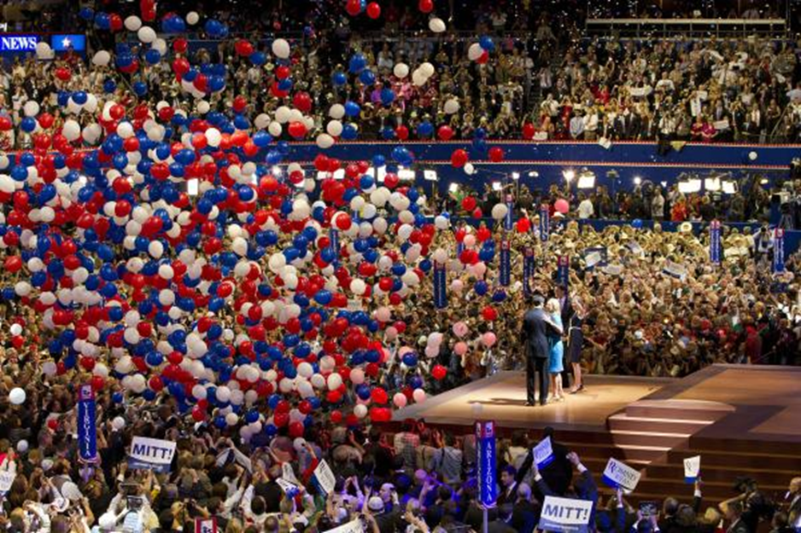
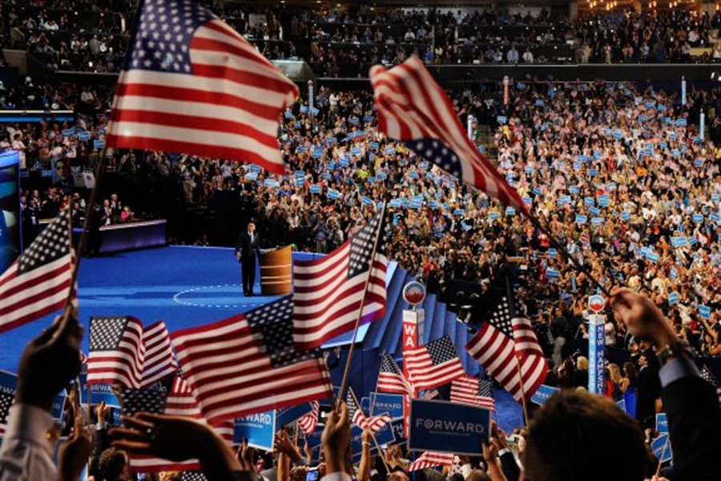
What happens at the parties’ national conventions?
Republican National Convention 2012
Democratic National Convention 2012
Party delegates from 50 States convene
Winner of the party’s primary election announced
The party’s candidate for President is announced
Nominee presents himself
Nominee presents his running mate for Vice President
Notes:
Each party has its own national convention where it chooses, officially nominates its candidate for presidency. This year the Republican National Convention is being held in Tampa, FL from August 27-30 and will be the formal decision on the Republican nominee from the candidates that have been running in the primaries from January to June. Since this is an incumbent year the Democratic National Convention this was more of a formality then necessity (since no one is running against Obama for the Democratic nomination) and was held in Charlotte, NC on September 4 through September 6.
Images: Republican Convention- upi.com, Democratic Convention- swampland.time.com

Slide 29
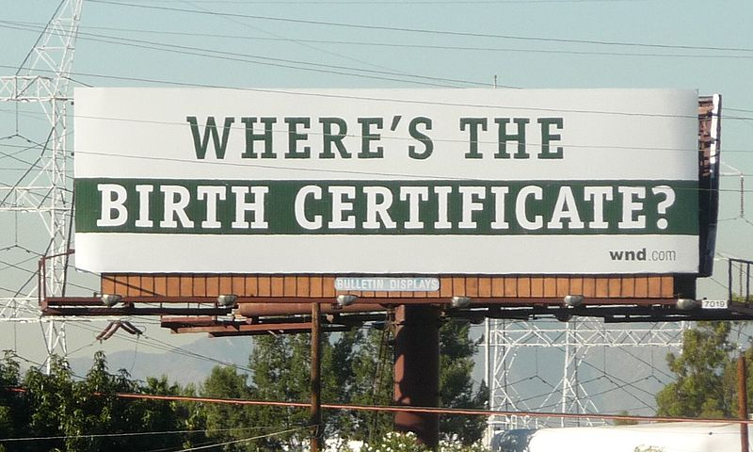
After the Conventions: The Gloves Come Off
Campaign Ad Blitz
Stump Speeches and Campaign Caravans
Presidential polls, polls, and more polls
Focus on swing states
Obama birth certificate controversy
Notes:
Campaign ads can be positive or negative.
Swing states are the states where the race is close and which could tip the race to one candidate (esp. larger states with more electoral votes). (More population equals more electoral votes).

Slide 30
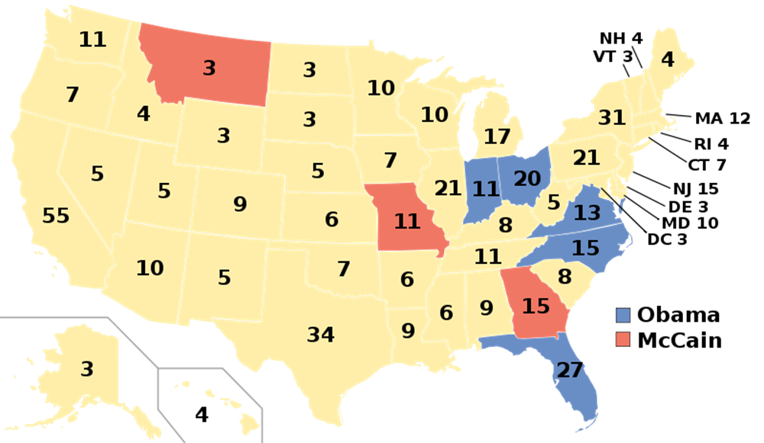
Swing States (2008)
Source: wikipedia.org
Notes:
Here you can see some of the swing states. The campaigning is really relentless in these states, you always here a lot about Illinois. Florida is also a really big player, as you can see it has a lot of electoral votes. It was big player in the 2000 election between Bush and Gore, they called for a recount of the votes in Florida because it was so close, and it really came down to that state in determining the election.

Slide 31
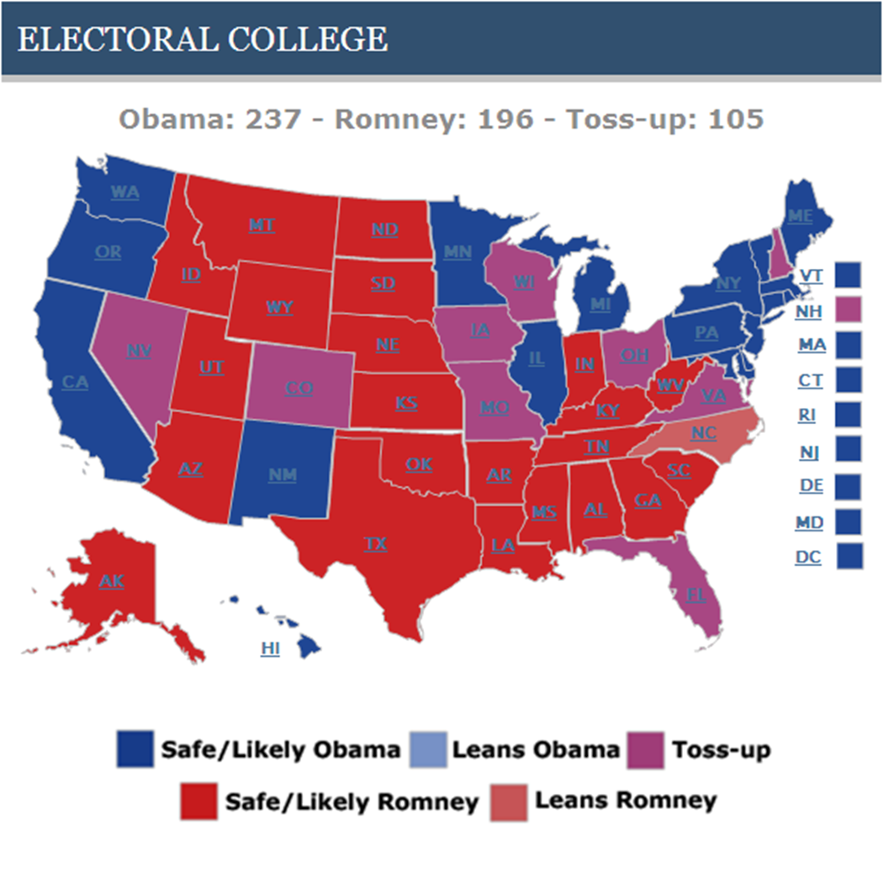
Source: www.rasmussenreports.com

Slide 32
The election campaign is in full swing: Swing states flooded with TV ads
What do the following ads try to achieve and how do they do it?
https://www.youtube.com/watch?v=G6vMqnP3TM4&feature=related
https://www.youtube.com/watch?v=sq3GGwgV7R0
http://www.youtube.com/watch?v=Ud3mMj0AZZk&feature=player_detailpage
Notes:
What do these ads try to achieve and how do they do it?

Slide 33
What did you notice about the essence of these ads?
In Richmond in Virginia, a swing state media market, not a single positive presidential campaign message ran on television from June 9 through June 22, but attack ads ran 4,504 times.
[source: Kantar Media, which tracks television advertising nationwide]

Slide 34
What do you need to be successful?
Name Recognition and personality
Convincing political message and agenda
Strong, competent, experienced, well organized campaign team with sufficient number of volunteers
Campaign strategy
Money
Luck
Notes:
Many candidates are simply not known to voters at this stage, so anyone with Name Recognition has an advantage.
To motivate voters to support a candidate in the primaries (early in the year when people aren’t yet interested in the election) takes an organization which can knock on doors and work at the grassroots level.
Americans more than perhaps Germans want to feel like they know a candidate personally, or at least understand “what makes them tick”. This explains why in America the families of candidates are involved in many campaign appearances (and make important speeches at conventions). This doesn’t seem to happen in Germany.
Money is important for several reasons (next slide).

Slide 35
Barack Obama What do you know about him?
Born in Hawaii
Studied at Columbia and Harvard University
Worked at Wall Street for a short while
Became a community organizer in Chicago
Senator from Illinois 2004 - 2008

Slide 36
Mitt Romney What do you know about him?
Harvard graduate
Former successful investment banker
Governor of Massachusetts
2002 – 2006
Mormon

Slide 37
What are Obama’s and Romney’s advantages and disadvantages?
Notes:
What is an Incumbent?

Slide 38
Incumbents versus Challengers
Incumbents have the advantage:
Name recognition
Can build on organization/volunteers from first campaign
Can build on fundraising infrastructure from first campaign
Challengers can do well if the incumbent
Can be blamed for negative developments
Is associated with unpopular policies
Is not as charismatic as the challenger
Suffers from recent scandal
Notes:
What is an Incumbent?

Slide 39
What will be the key Election Issues?
The economy
Health care reform
Budget & fiscal policies

Slide 40
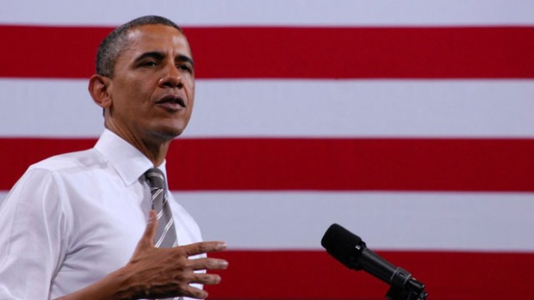
Other Factors
Unforeseen events at home (natural disaster, etc.)
Global affairs
Others (Obama’s public support of gay marriage)
“Social issues may not turn election but will influence voters
Analysts say Obama's support of gay marriage could be risky in swing states”
Source: cnn.com

Slide 41
What is a key factor in campaign strategy?
The U.S. election system

Slide 42
How do you win the U.S. Presidential election?
You have to win the majority of the “electoral votes”

Slide 43
What are the “electoral votes”?
“Electoral votes” are cast by the “Electors” in the “Electoral College” who vote for the Democratic or Republican candidate

Slide 44
Who are the “Electors”?
Each one of the 50 states sends Electors to the Electoral College. The number of Electors equals the number of each state’s number of representatives in the Senate (2 for every state) plus the number of representatives in the House (= no. of congressional districts) which is dependent on size of population

Slide 45
Examples
Nebraska:
North Carolina:
California:
Notes:
This means:

Slide 46
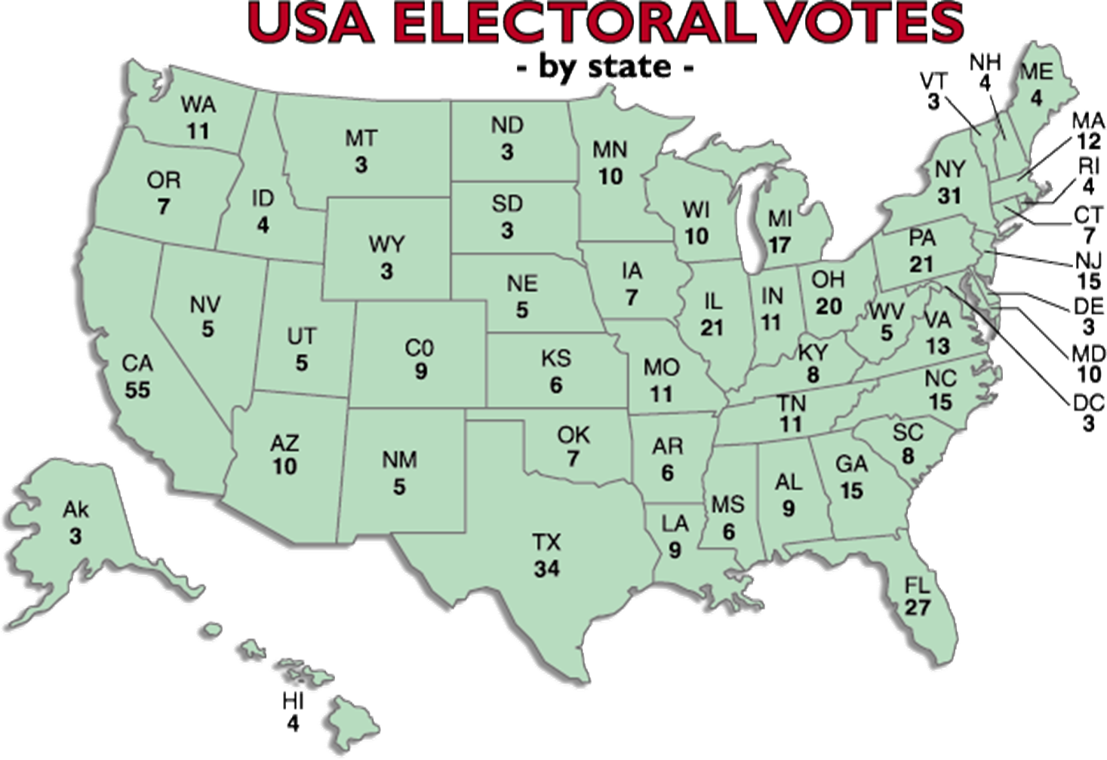
Notes:
270 electoral votes needed to win the presidency

Slide 47
How are a state’s electors divided between the candidates ?
They are not divided !
It is a “winner-takes-all” system:
The candidate who wins a simple majority of the votes gets all of the state’s electors who will later cast their votes for him in the electoral college

Slide 48
Example
If Obama wins 48% and Romney 47% of the votes in California, Obama wins all 55 electors, Romney 0 electors

Slide 49
Can you win the presidency without a majority of popular votes?
Notes:
Need 270 electoral votes to win the presidency, can be won with a minimum of

Slide 50
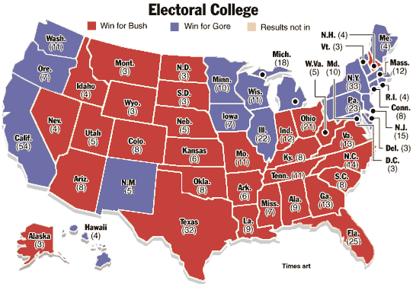
Yes! Example: The 2000 Elections
Gore popular votes: 51,003, 926
Bush popular votes: 50,460,110

Slide 51
Why does the U.S. use the electoral college?
Part of the original system of checks and balances
Tradition
Controversy after 2000 election to move towards a system of popular vote
Probably won’t happen anytime soon

Slide 52
What is the candidates’ goal?
To win the simple majority of votes state by state and win them in the states that matter.
The states that matter are the ones with a large population which therefore have a high number of electoral votes

Slide 53
What does this mean for campaign strategy?
The candidates concentrate on the bigger states which they have a chance of winning, particularly on “swing states”

Slide 54
Source: www.rasmussenreports.com

Slide 55
Which voter group will the candidates have to pay particular attention?

Slide 56
Major stepping stones on the way to election day: Presidential and Vice-Presidential TV debates
The parties agree on the number, location and format of the debates
They feature the candidates for a national audience
Notes:
Very important for campaign (make or break sometimes), focus is on rhetoric as well as image during the debate. These really go a long way in the election, and the commentators afterwards often discuss who “won” the debate. As we just mentioned not only rhetoric but also image. A good example was the first televised debate in 1960 between JFK and Nixon. People who listened to the debate on the radio thought that Nixon won the debate because he was a better speaker, but people who watched it on television thought that Kennedy won the election because he looked much better than Nixon, much younger and energetic.

Slide 57
What is important for Election Day?
Have voters registered who are likely to vote for you
Mobilize your base
Mobilize independents
Help your likely voters in casting their votes (Where are the Polling Stations?)
Notes:
Contrast to Europe: Elections on a normal Tuesday (no holiday).
Where do Americans go to vote? Schools, churches, public buildings.
Media widely criticized in 2000 for calling the race early, discouraging voters from going to polls. Should be more cautious this time.

Slide 58
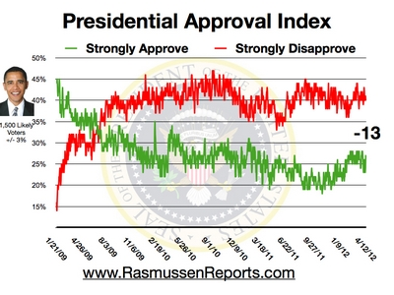

Slide 59
Obama & Romney in current polls
Poll | Date | Obama | Romney | Spread
RCP Average | 9/11 - 9/23 | 48.6 | 44.9 | Obama +3.7
Politico/GWU/Battleground | 9/16 - 9/20 | 50 | 47 | Obama +3
Rasmussen Tracking | 9/21 - 9/23 | 47 | 46 | Obama +1
Gallup Tracking | 9/17 - 9/23 | 48 | 46 | Obama +2
National Journal | 9/15 - 9/19 | 50 | 43 | Obama +7
NBC News/Wall St. Journal | 9/12 - 9/16 | 41 | 43 | Obama +8
Source: RealClearPolitics

Slide 60
What kinds of developments and events could impact on the election outcome in November?
1. Domestically?
2. Abroad?

Slide 61
“If you were successful, somebody along the line gave you some help. There was a great teacher somewhere in your life. Somebody helped to create this unbelievable American system that we have that allowed you to thrive. Somebody invested in roads and bridges. If you’ve got a business -- you didn’t build that. Somebody else made that happen. The Internet didn’t get invented on its own. Government research created the Internet so that all the companies could make money off the Internet. The point is, is that when we succeed, we succeed because of our individual initiative, but also because we do things together. There are some things, just like fighting fires, we don’t do on our own. I mean, imagine if everybody had their own fire service. That would be a hard way to organize fighting fires. So we say to ourselves, ever since the founding of this country, you know what, there are some things we do better together.” Barack Obama at a Campaign Event in Roanoke, Virginiam July 13, 2012

Slide 62
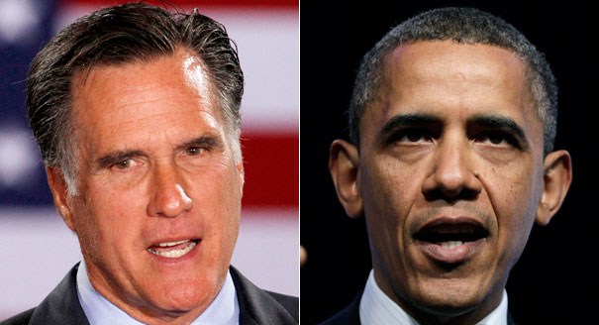
Whom would you vote for, if the election were held today and why?

Slide 63
Questions (on anything)

